Slide 1
Software Engineering and Architecture
Concurrency
Producer Consumer

Slide 2
Recap
The three categories of concurrent programs
Independent threads
Like running your Media player program while coding in IntelliJ
Shared resources
Like two threads reading/writing to the same account object
Typical case: web servers handling resources
You cannot book the same train seat twice!
Collaborating processes
Like one thread inserting into a buffer and assuming some other thread will remove those items from the buffer

Slide 3
Collaborating Threads
The last, and most challenging, class of concurrent programs is collaborating processes
The typical example is the Producer Consumer
For instance
Printer queue; high volume web traffic; disk read/write; …
Producer
Buffer
Consumer

Slide 4
Buffer
Producer(s) and Consumer(s) are threads, and
Our Buffer (queue) class has methods
synchronized void store(Object o) Insert ‘o’ into buffer
synchronized Object retrieve() Retrieve ‘o’ from buffer
Both must be critical regions - guarded by Lock or synchronized
Consider the ‘consumer’ that wants to retrieve the next item ‘o’ to process it
But if there is no item in the queue, it of course has to wait until there is an item available; that is, a producer has stored something into the queue…

Slide 5
Waiting for item to be available
Waiting for item ‘o’ to become available
Let us analyze our options…
?
Buffer
Consumer

Slide 6
Waiting for ‘o’
So, how do we arrange to wait for the item?
In the consumer code
Call ‘retrieve()’ repeatedly until it returns a non-null value
This is called polling (busy waiting), and wastes a lot of CPU cycles on nothing
… And there is a waiting time from item available to processing
Similar to picking up the phone every 1 minute to see if any has called you …
Wasting a lot of time and resources ☹
?
Buffer
Consumer

Slide 7
Waiting for ‘o’
So, how do we arrange to wait for the item?
In the queue code’s retrieve() method
Wait inside – but hey! It is a critical region and thus no producer can ever enter the ‘store()’ method’s critical region ☹
Deadlock
A thread waits infinitely for an event that will never happen
Buffer
Consumer

Slide 8
Deadlock
Repeat (as it is important!)
We would like to wait in the queue code
retrieve() is called and then just returns when there is item available
But we cannot because
retrieve() will take the ‘lock’ on the object and thus no other thread will ever be able to call the method store()
Waiting for the lock outside…

Slide 9
So We Want…
… a mechanism that
awaits that a condition becomes true
Let other threads acquire the lock so they can make that condition true
Not Java code!
class Queue {
Object p;
boolean empty = true;
public synchronized Object retrieve() {
await (!empty);
empty = true;
return p;
}
public synchronized void store(Object p) {
await (empty);
this.p = p; empty = false;
}
}

Slide 10
Example
Scenario
C call retrieve()
Takes lock
Empty == true
Release lock and
Enter Waiting state
P calls store()
Takes lock
No wait (empty)
Finish and release lock
Later: Scheduler force P into ready state (not running)
C enters ‘running’ state
Takes lock
Empty = false!
Finish and release lock
class Queue {
Object p;
boolean empty = true;
public synchronized Object retrieve() {
await (!empty);
empty = true;
return p;
}
public synchronized void store(Object p) {
await (empty);
this.p = p; empty = false;
}
}
! true => ‘await’

Slide 11
Example
Scenario
C call retrieve()
Takes lock
Empty == true
Release lock and
Enter Waiting state
P calls store()
Takes lock
No await (empty == true)
Toggle empty and release lock
Later: Scheduler force P into ready state (not running)
C enters ‘running’ state
Takes lock
Empty = false!
Finish and release lock
class Queue {
Object p;
boolean empty = true;
public synchronized Object retrieve() {
await (!empty);
empty = true;
return p;
}
public synchronized void store(Object p) {
await (empty);
this.p = p; empty = false;
}
}
true => continue

Slide 12
Example
Scenario
C call retrieve()
Takes lock
empty == true
Release lock and
Enter Waiting state
P calls store()
Takes lock
No await (empty == true)
Toggle empty and release lock
Later: Scheduler force P into ready state (not running)
C enters ‘running’ state
Takes lock
No await (empty == false)
Finish and release lock
class Queue {
Object p;
boolean empty = true;
public synchronized Object retrieve() {
await (!empty);
empty = true;
return p;
}
public synchronized void store(Object p) {
await (empty);
this.p = p; empty = false;
}
}
true => continue

Slide 13
Java Primitives (Java 1.4)
Java objects maintain a wait-set in addition to the lock
a.wait() does atomically
Force current thread into waiting state,
Add current thread in object’s wait-set
Release the lock on the object, a
a.notify() does
Choose one random thread, T, in a’s wait-set
T must take the lock on ‘a’
May fail if another thread has already taken the lock!
T resumes execution (becomes runnable) from the wait() statement
a.notifyAll() does
The same except all threads in a’s wait-set become ‘runnable’…
a

Slide 14
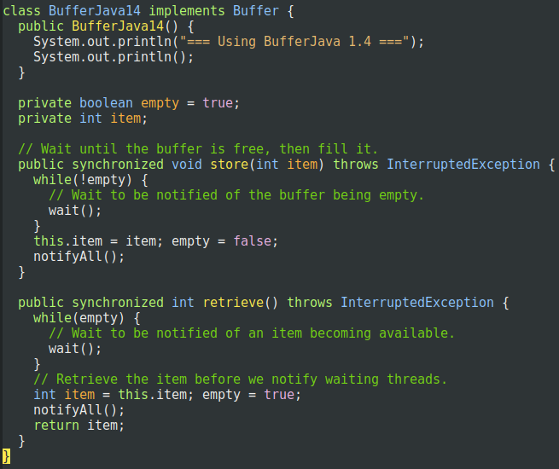
Java 1.4 Code

Slide 15
Java 1.4 Code
Why a loop around wait() ???
Notes:
Hint: What if 10 threads are waiting in Wait()?

Slide 16
Note
The wait-set only makes sense inside a critical region
You cannot call ‘wait()’ or ‘notify()’ if you are not in a synchronize method / critical region
Will throw exceptions at your if you try…

Slide 17
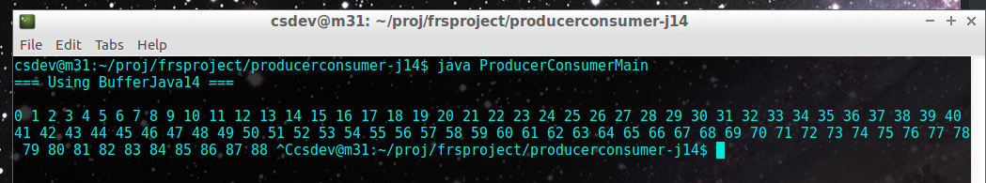
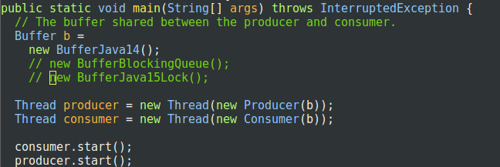
Demo

Slide 18
Java 5 Onwards

Slide 19
Critique
Java was the first mainstream language to have internal threading
Brink Hansen should have said that all his whole lifelong research into concurrency was a complete waste ☹
Morale: It had to be improved…
Package: java.util.concurrent
Much more fine-grained concurrency control
A lot of default implementations without bugs!

Slide 20

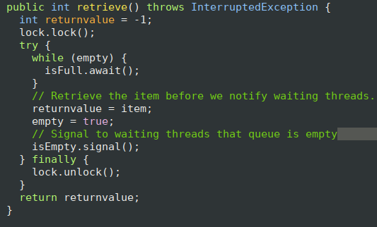
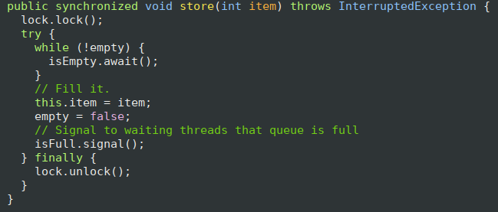
Java 1.5 Code
The Lock
Two different wait-sets associated…
Now, producers are waiting in one wait-set; while consumers are in another! We are sure to signal the right one!

Slide 21

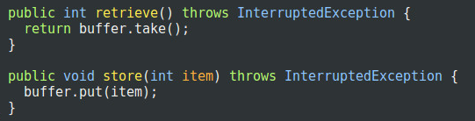
And Even More Easy!
It is already implemented !

Slide 22
Moving On…

Slide 23
Vast Subject Area
Lots of properties of concurrent programs
Liveliness
Fairness
Starvation
Deadlocks
Performance / blocked threads
Thread priority
And library support
Java Collection classes are not thread safe ☹
But Decorators exists
List newList = Collections.synchronizedList(oldList);

Slide 24
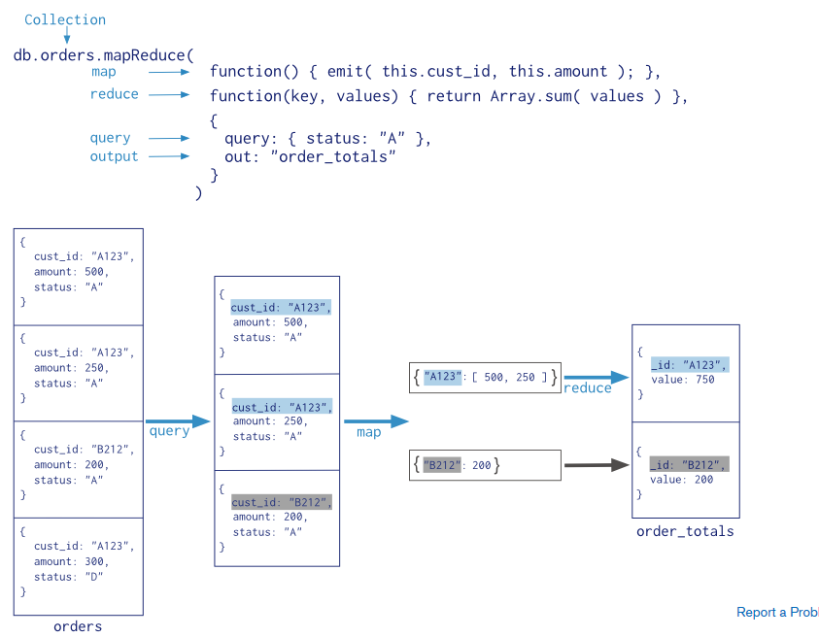
Vast Subject Area
And Parallelism – the other side of concurrency
Java Stream processing
Runs concurrently if you use parallelStream()
Map-Reduce
Why not use 1.000 machines to compute ‘f’?
And on, and on, and on…

